Slide 1
Malicious URL Prediction
Team: 411021314 林芝蓁

Slide 2
Main Programming Language: Python

Slide 3
Table of Contents
Part 1
Dataset Description
Source
Download the dataset by program
Update the dataset everyday
Feature Selection
Fields description
How to select the features
Basic Plots for the dataset (Histogram, Heat map)
Analyze method
Training Modal
Python Code
Evaluation
Average Accuracy with Varying Test Size( line plot)
Accuracy without a specific feature
Part 2
Application
Dataset
Feature Extraction
Accuracy
Prediction by given URLs
Website
Part 3
Issues
Shortcoming of the project
Future Evolution
2. Conclusion

Slide 4
Part 1
Dataset Description
Feature Selection
Analyze method
Evaluation

Slide 5

I.DataSEt Description
Resource
01
The Canadian Institute for Cybersecurity (CIC) is a comprehensive multidisciplinary training, research and development, and entrepreneurial unit that draws on the expertise of researchers in the social sciences, business, computer science, engineering, law and science.
Based at the University of New Brunswick in Fredericton, the institution is the first of its kind to bring together researchers and practitioners from across the academic spectrum to share innovative ideas, create disruptive technology and carry out groundbreaking research into the most pressing cybersecurity challenges of our time.
Canadian Institute for Cybersecurity
URL dataset (ISCX-URL2016)

Slide 6
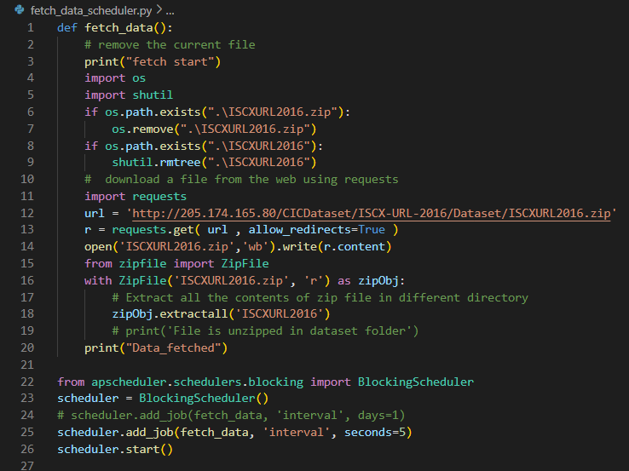
Fetch_data_scheduler.py
I.DataSEt Description
Download by program
02
Way1: Request, scheduler

Slide 7
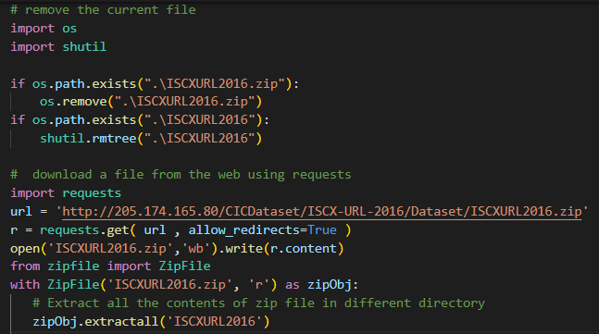
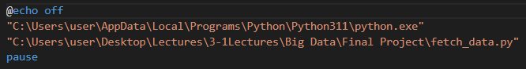
Fetch_data.py
I.DataSEt Description
Download by program (contd.)
02
Fetch_data.BAt
Way2: Request, Task Scheduler

Slide 8
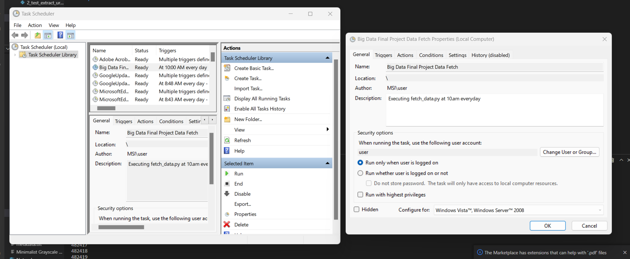
I.DataSEt Description
Create Basic Task > Name the task > set time > start a program > browse(select the batch) > finish
03
Update the dataset everyday
Task Scheduler

Slide 9
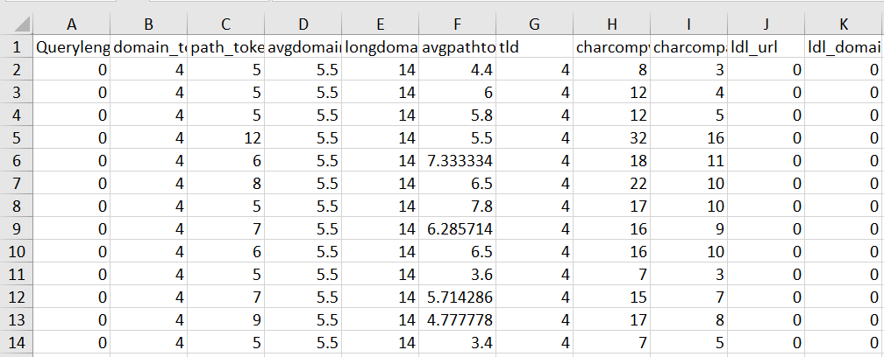
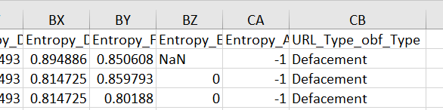
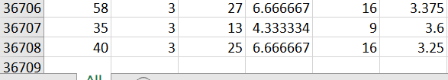
II.Feature selection
Field description
01
36708 ROWS * 80 COLUMNS
ISCXURL2016\FinalDataset\All.csv“
Drop The columns with NANs and INFs
(C:\AMP\Apache24\htdocs\Big Data Final Project\1_analyze_ISCXURL2016.py)

Slide 10
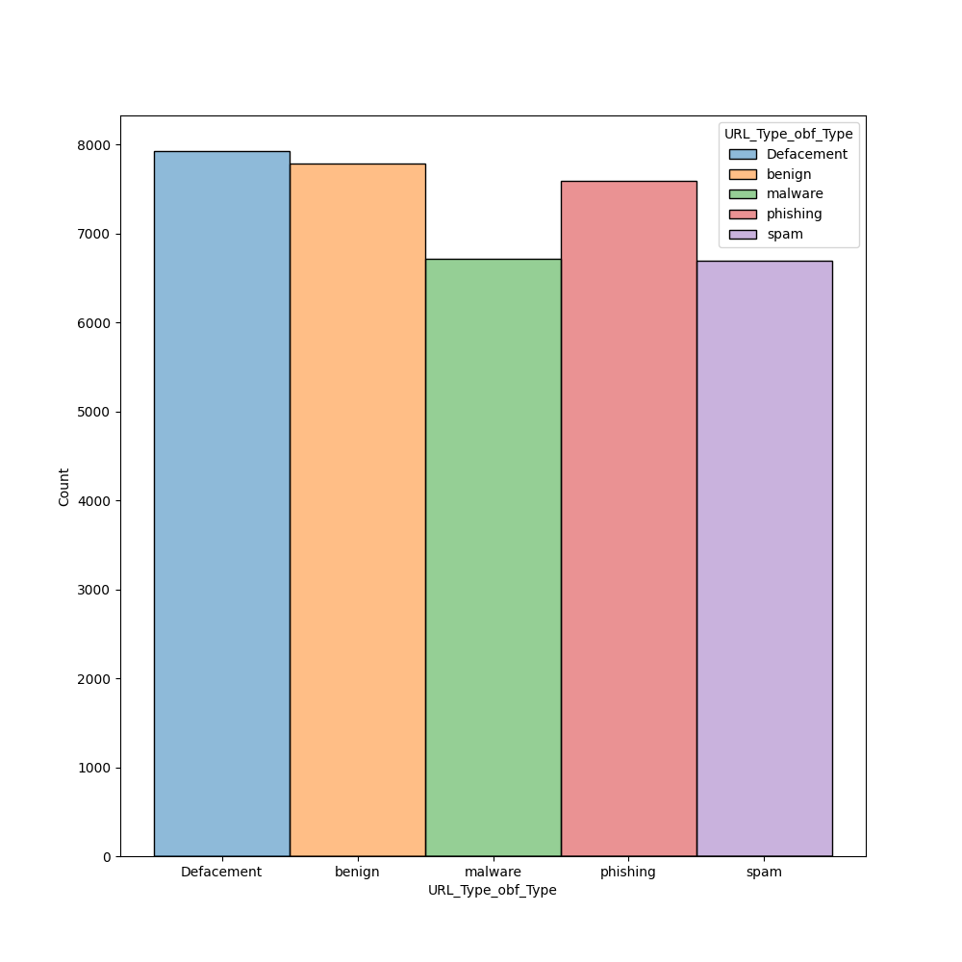
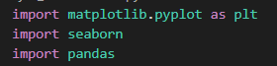
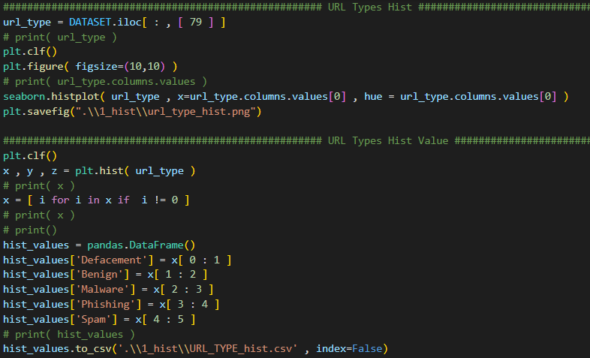
II.Feature selection
02
Histogram of number of URL types
C:\AMP\Apache24\htdocs\Big Data Final Project\1_hist
Defacement | Benign | Malware | Phishing | Spam
7930 | 7781 | 6712 | 7586 | 6698
Matplotlib, Pandas
C:\AMP\Apache24\htdocs\Big Data Final Project\1_analyze_ISCXURL2016.py

Slide 11
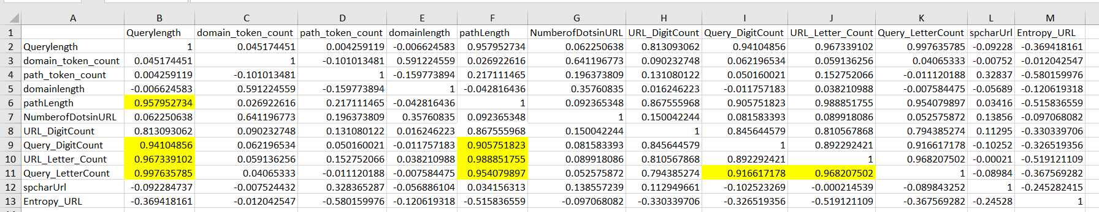
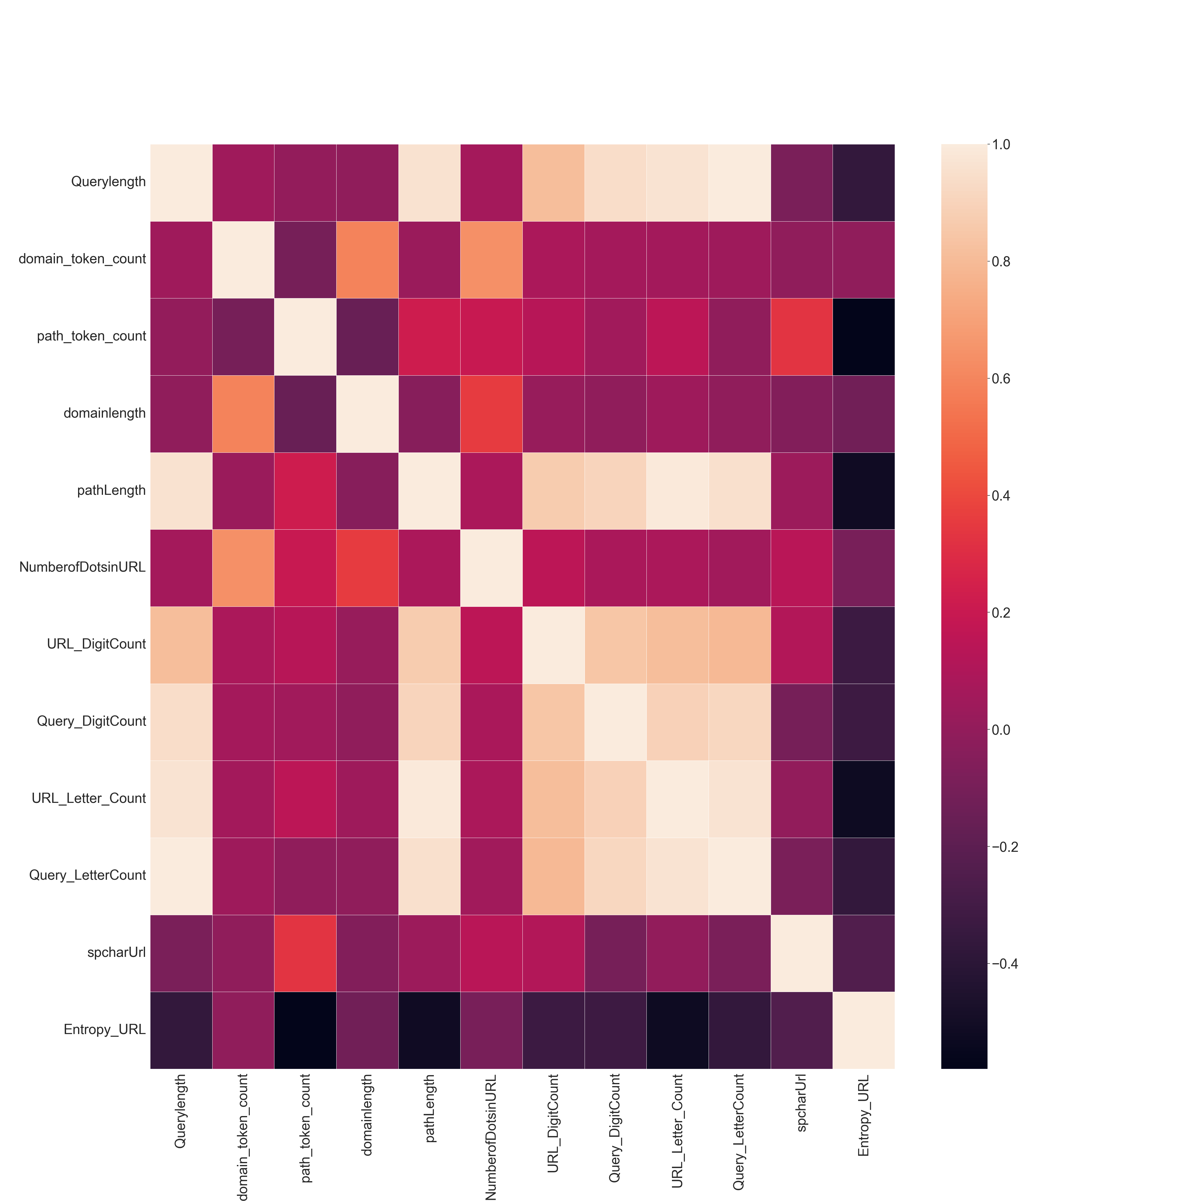
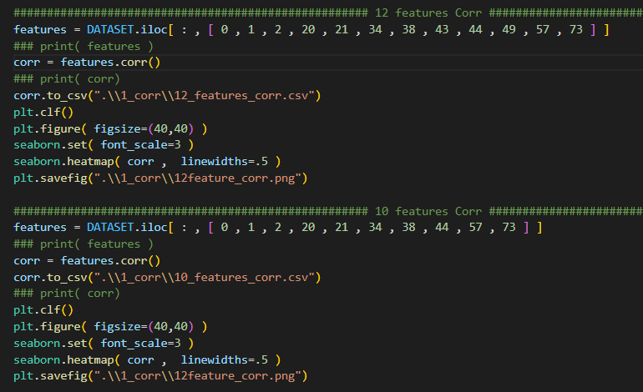
II.Feature selection
03
How to select the features
"C:\AMP\Apache24\htdocs\Big Data Final Project\1_corr"
Lexical Properties, Heatmap
Querylength, domain_token_count, path_token_count,
Domainlength, pathLength, NumberofDotsinURL,
URL_DigitCount, Query_DigitCount, URL_Letter_Count,
Query_LetterCount, spcharUrl Entropy_URL
C:\AMP\Apache24\htdocs\Big Data Final Project\1_analyze_ISCXURL2016.py

Slide 12
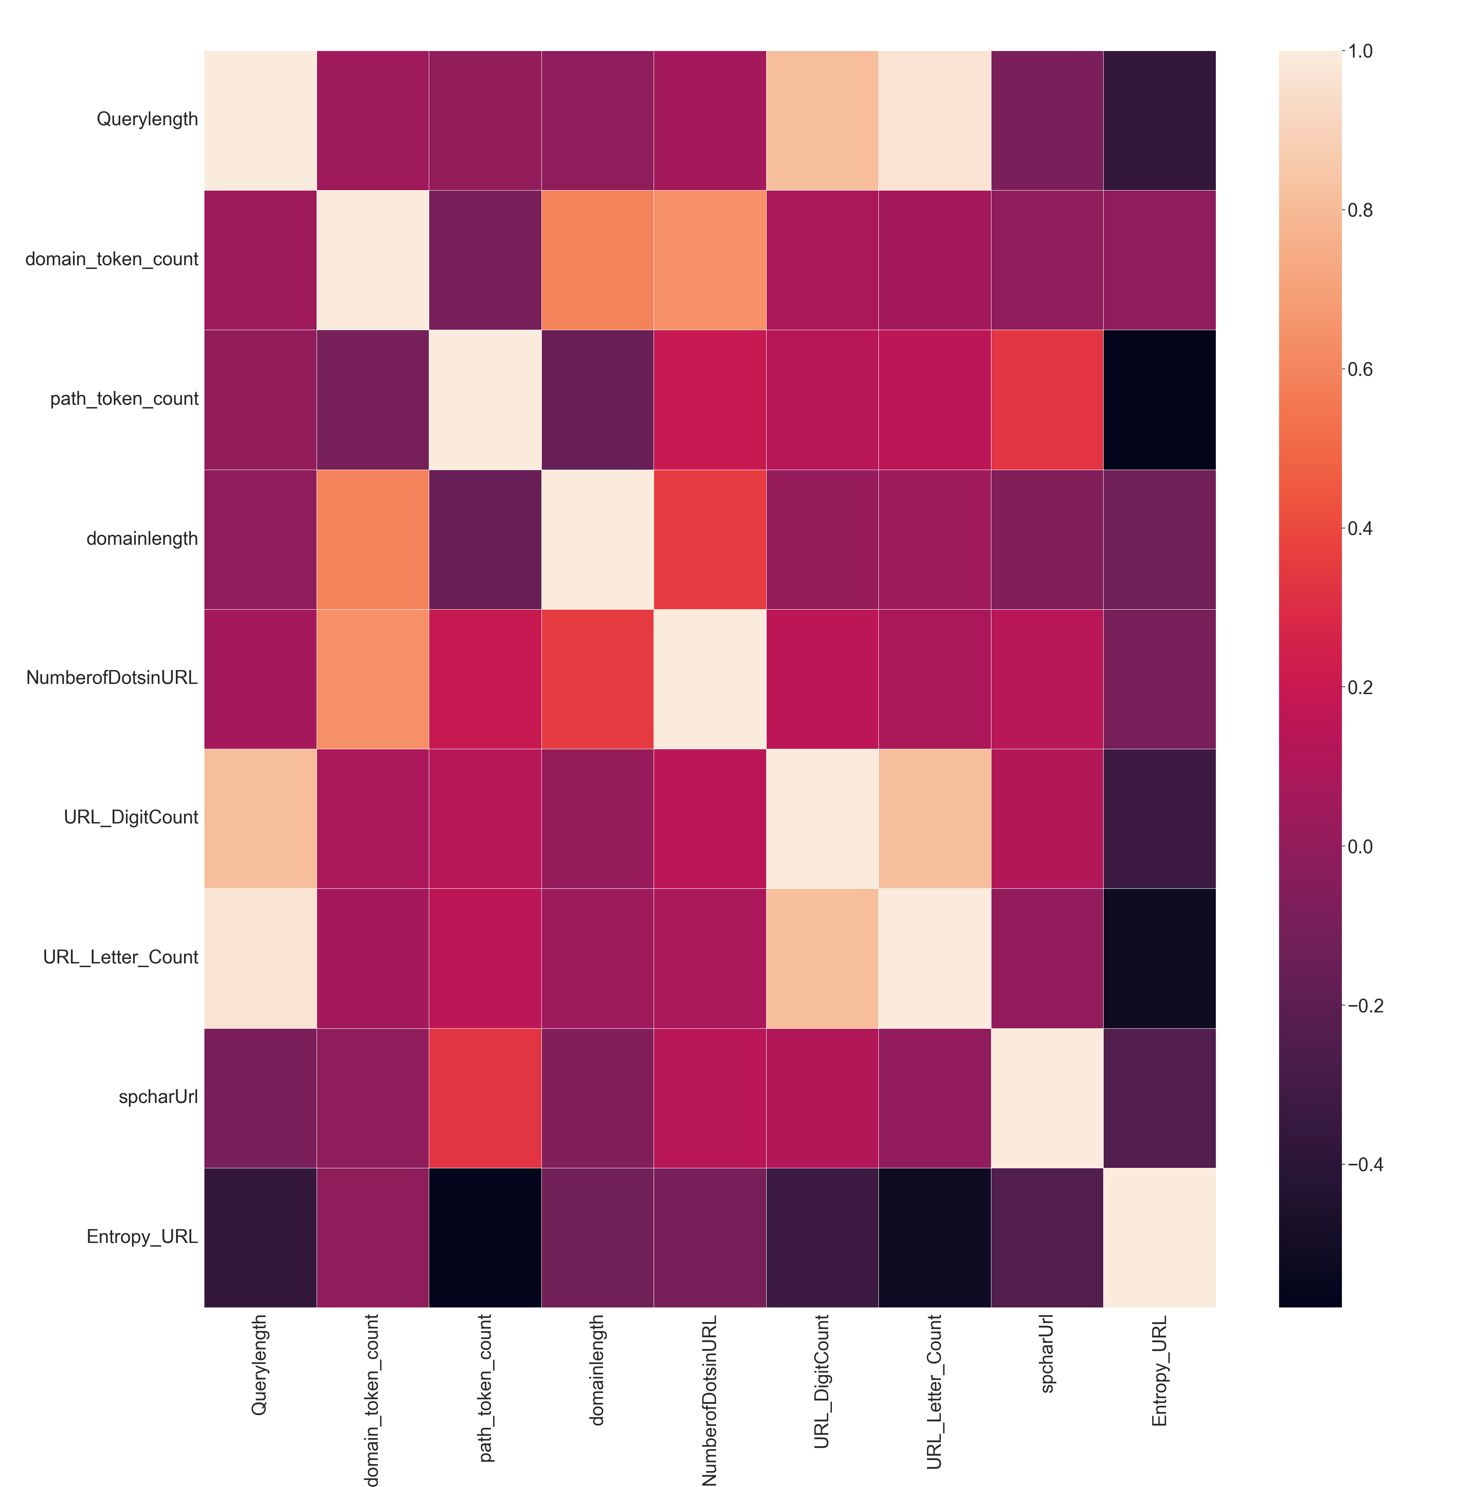
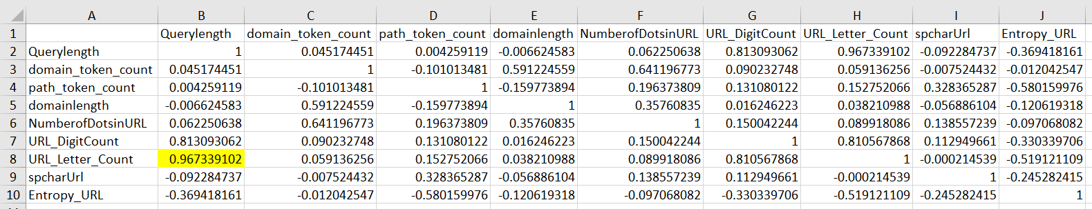
II.Feature selection
03
How to select the features(contd.)
Querylength, domain_token_count, path_token_count,
Domainlength, pathLength, NumberofDotsinURL,
URL_DigitCount, Query_DigitCount, URL_Letter_Count,
Query_LetterCount, spcharUrl Entropy_URL
"C:AMP\Apache24\htdocs\Big Data Final Project\1_corr"

Slide 13
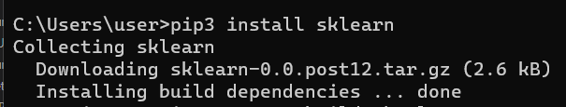
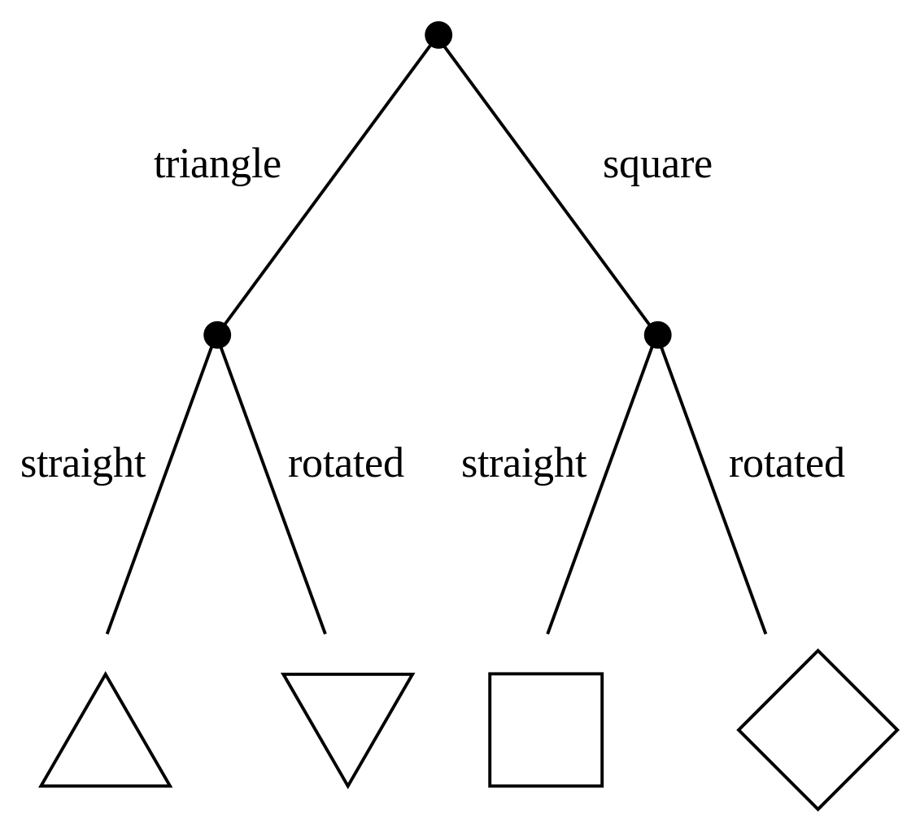
III. Analyze method
01
Training Modal
Classification—Decision Tree
scikit-learn: a free software machine learning library for the Python programming language.

Slide 14
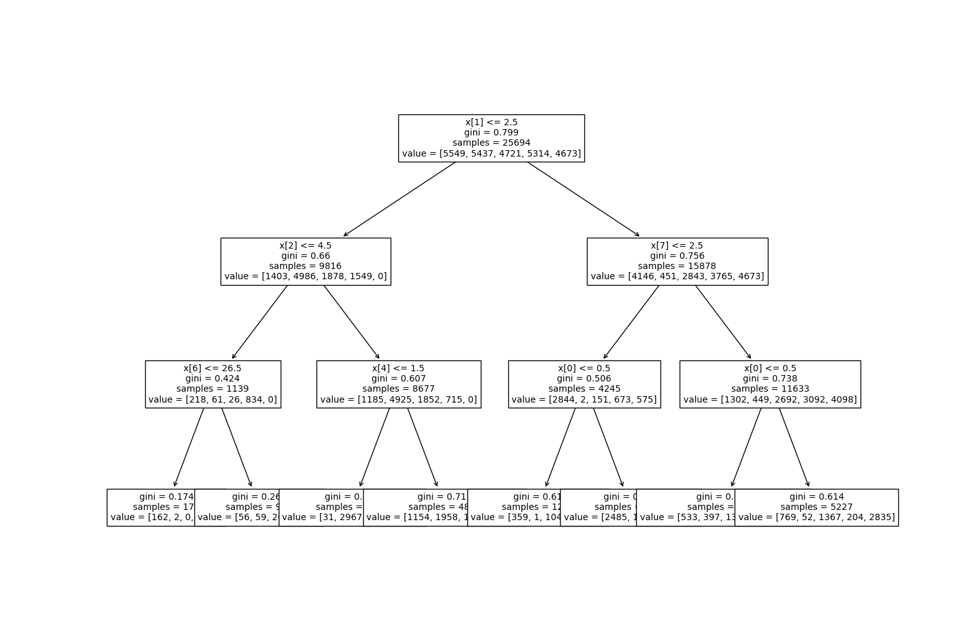
MAX_DEPTH = 3
C:\AMP\Apache24\htdocs\Big Data Final Project\1_test_accuracy.py

Slide 15
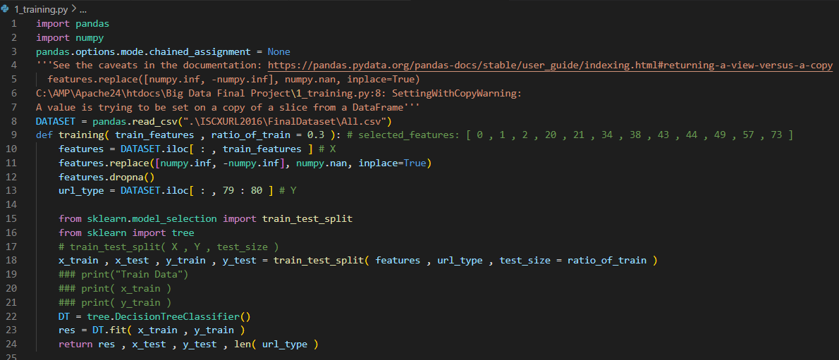
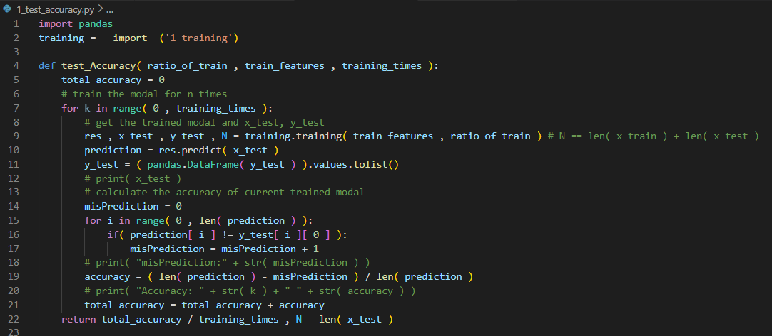
III. Analyze method
02
Python code
C:\AMP\Apache24\htdocs\Big Data Final Project\1_training.py
import pandas
import numpy
from sklearn.model_selection import train_test_split
from sklearn import tree
C:\AMP\Apache24\htdocs\Big Data Final Project\1_test_accuracy.py

Slide 16
III. Evaluation
01
Accuracy with varying test size
CODE
LINEPLOT

Slide 17
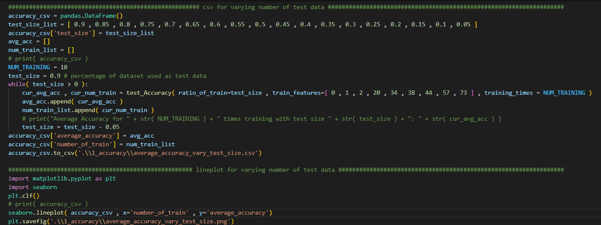
Code for accuracy with varying test size
C:\AMP\Apache24\htdocs\Big Data Final Project\1_test_accuracy.py

Slide 18
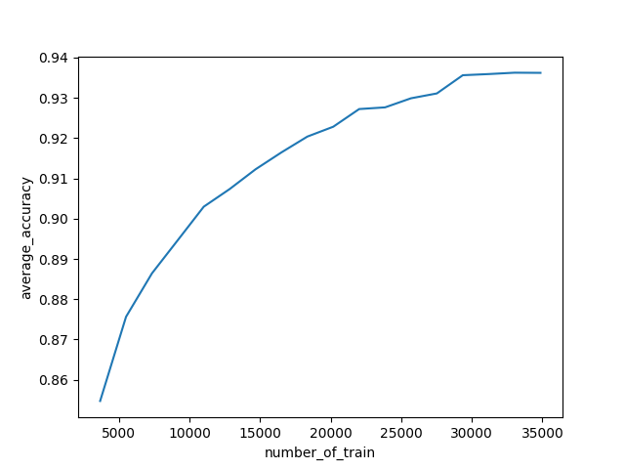
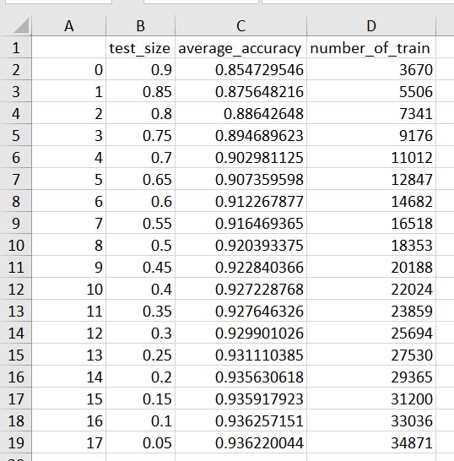
accuracy with varying test size
“c:\AMP\Apache24\htdocs\Big Data Final Project\1_accuracy\average_accuracy_vary_test_size.csv"
C:\AMP\Apache24\htdocs\Big Data Final Project\1_accuracy\average_accuracy_vary_test_size.png

Slide 19
III. Evaluation
02
Accuracy without a specific feature
CODE
LINEPLOT

Slide 20
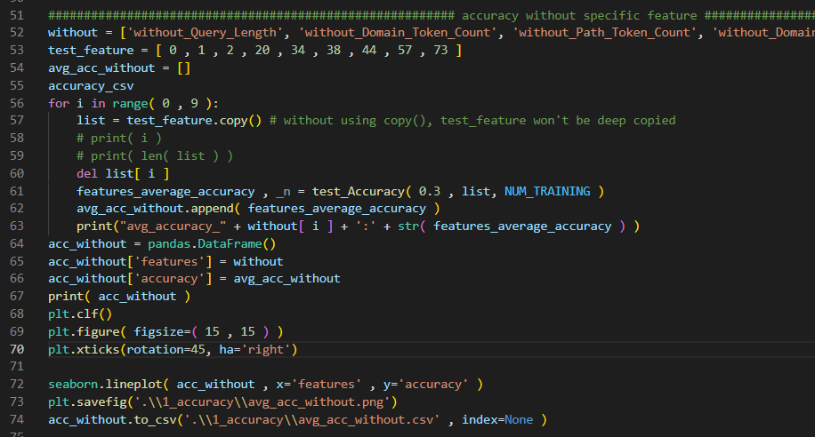
Accuracy without a specific feature code
C:\AMP\Apache24\htdocs\Big Data Final Project\1_test_accuracy.py

Slide 21
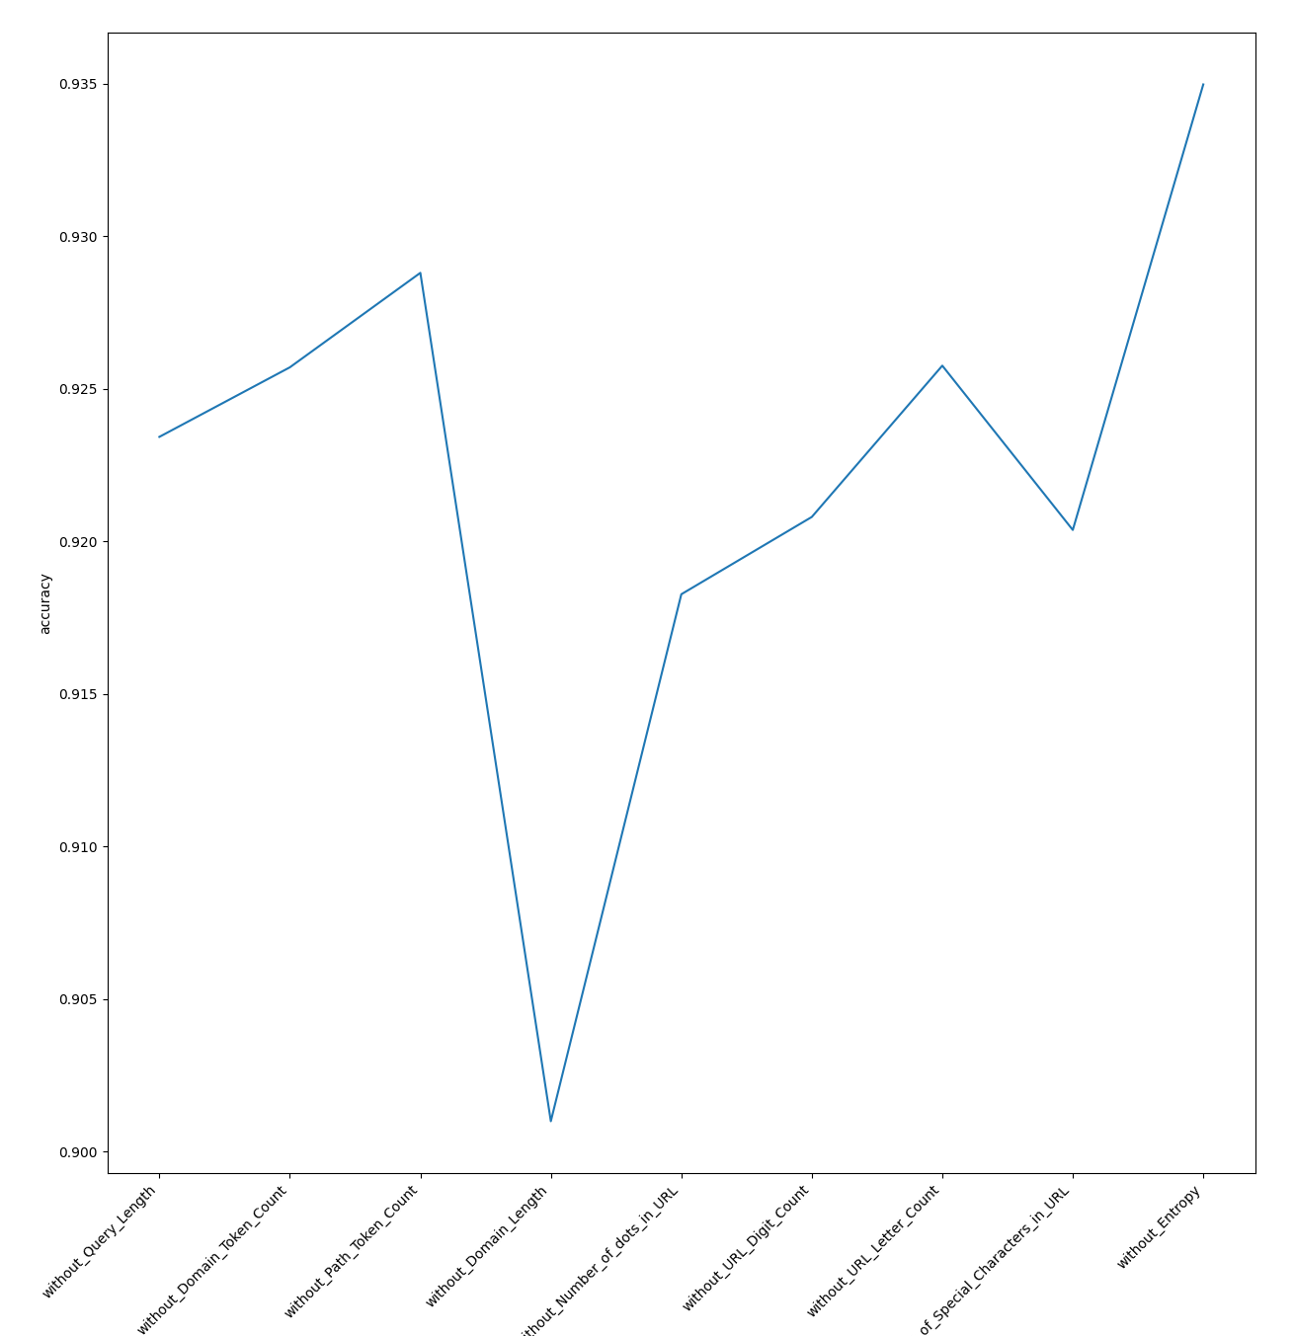
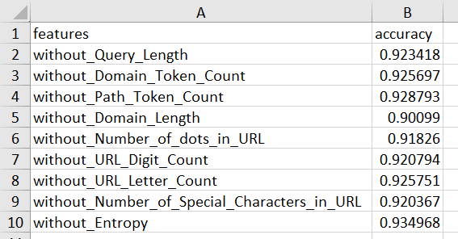
accuracy with varying test size
"C:\AMP\Apache24\htdocs\Big Data Final Project\1_accuracy\avg_acc_without.png"
"C:\AMP\Apache24\htdocs\Big Data Final Project\1_accuracy\avg_acc_without.csv"

Slide 22
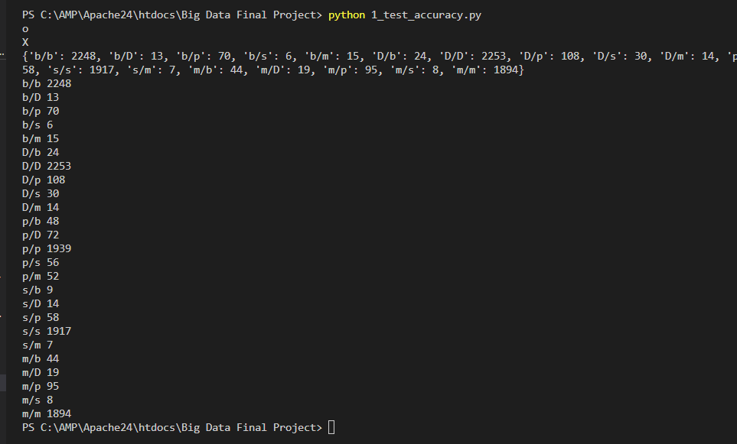
TRUE POSITIVE & FALSE POSITIVE
Prediction/Test_y:
b: benign
D: Defacemnt
p: phishing
s: spam
m: malware
C:\AMP\Apache24\htdocs\Big Data Final Project\1_test_accuracy.py

Slide 23
Part 2
Application
Website

Slide 24
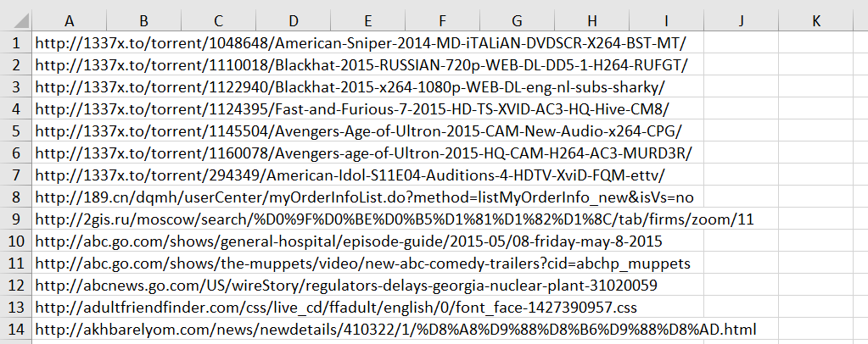
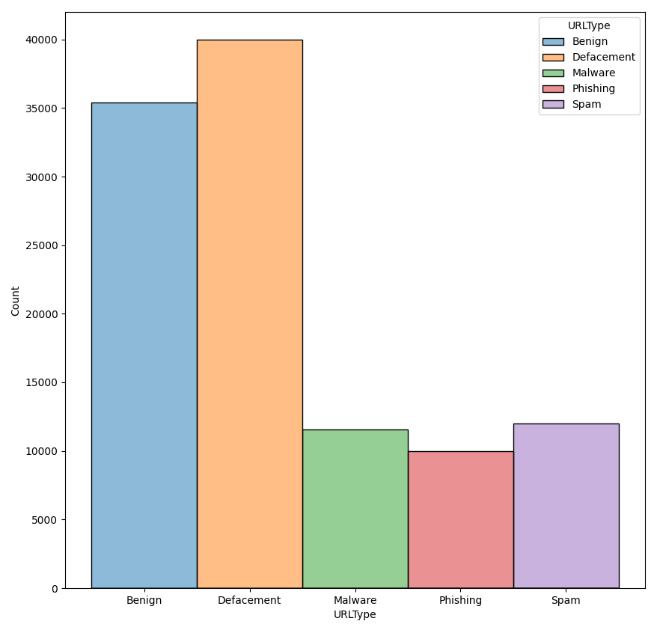
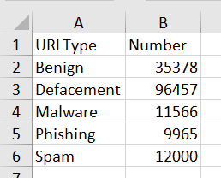
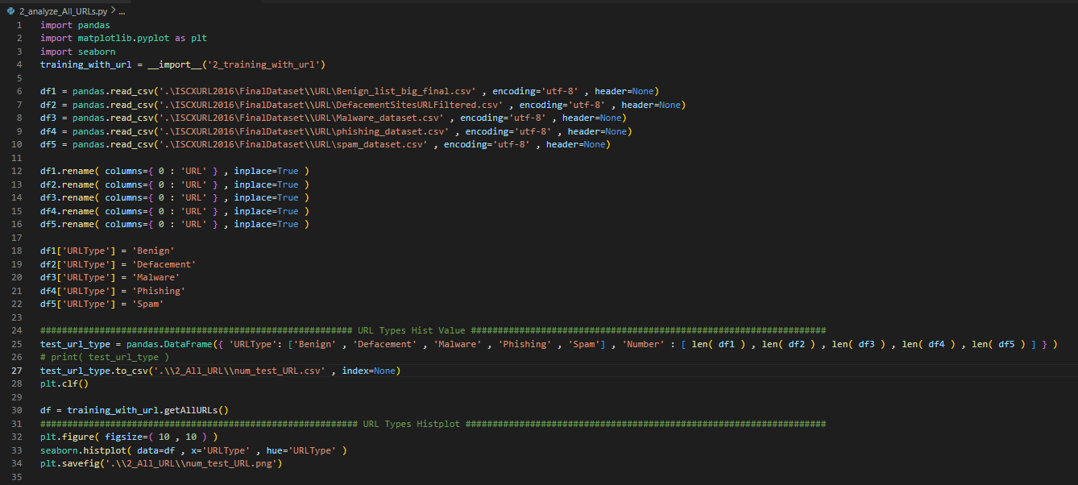
I. application
01
dataset
"C:\AMP\Apache24\htdocs\Big Data Final Project\ISCXURL2016\FinalDataset\URL\Benign_list_big_final.csv"
ISCXURL2016\FinalDataset\URL\Benign_list_big_final.csv"
ISCXURL2016\FinalDataset\URL\DefacementSitesURLFiltered.csv"
ISCXURL2016\FinalDataset\URL\Malware_dataset.csv"
ISCXURL2016\FinalDataset\URL\phishing_dataset.csv"
ISCXURL2016\FinalDataset\URL\spam_dataset.csv"
"C:\AMP\Apache24\htdocs\Big Data Final Project\2_All_URL\num_test_URL.png"
"C:\AMP\Apache24\htdocs\Big Data Final Project\2_All_URL\num_test_URL.csv"

Slide 25
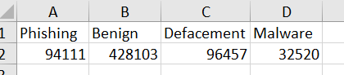
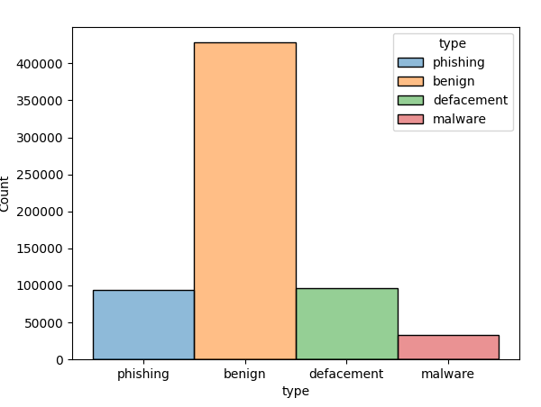
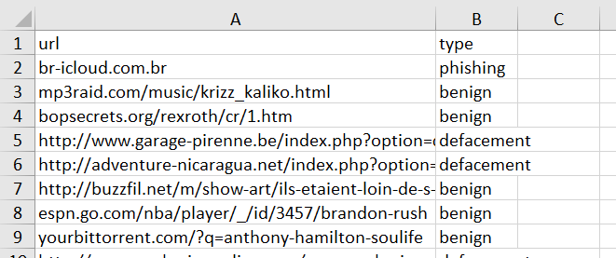
I. application
01
Dataset(contd.)
"C:\AMP\Apache24\htdocs\Big Data Final Project\2_Kaggle_hist\URL_TYPE_hist.csv"
Big Data Final Project\dataset\malicious_phish.csv“
https://www.kaggle.com/datasets/sid321axn/malicious-urls-dataset
651192 ROWS * 2 COLUMNS
"C:\AMP\Apache24\htdocs\Big Data Final Project\2_Kaggle_hist\URL_TYPE_hist.png"

Slide 26
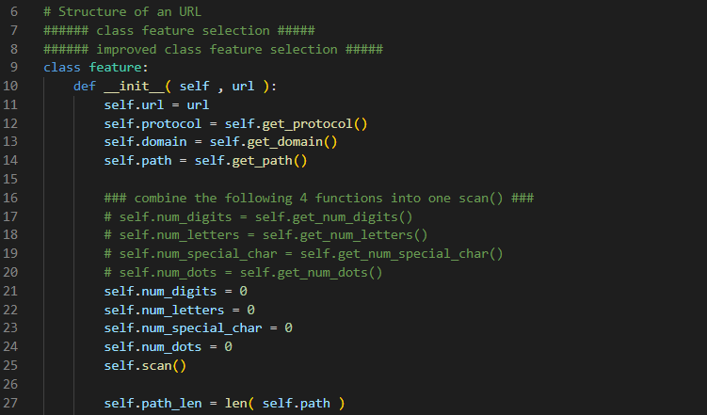
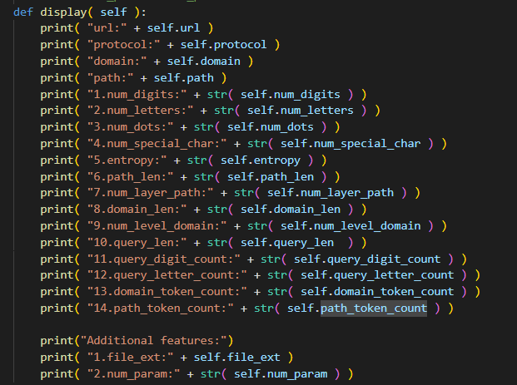
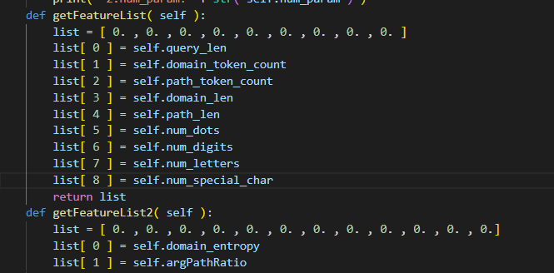
I. application
02
Feature extraction
!!! SEE !!!
C:\AMP\Apache24\htdocs\Big Data Final Project\2_extract_url_features.py

Slide 27
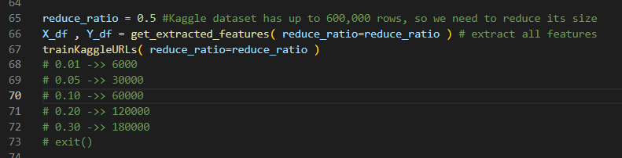
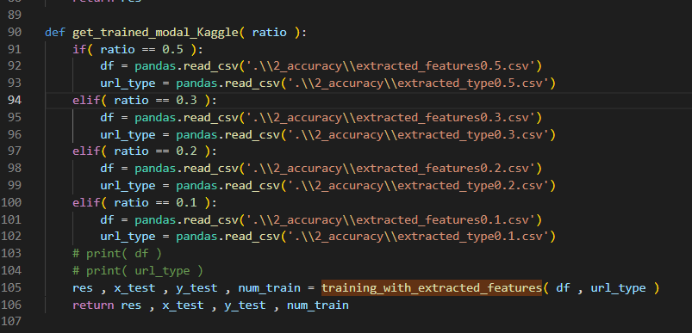
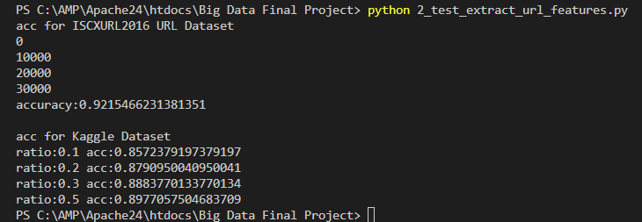
I. application
03
Accuracy
Accuracy by ISCXURL2016 & by Kaggle Dataset
Big Data Final Project\2_training_with_url.py
Big Data Final Project\2_test_extract_url_features.py
Extracted Features:
E.g., Big Data Final Project\2_accuracy\extracted_features0.5.csv“
“Big Data Final Project\2_accuracy\extracted_type0.5.csv"
Accuracy by ISCXURL2016 & by Kaggle Dataset
(Less than 30seconds)
C:\AMP\Apache24\htdocs\Big Data Final Project\2_training_with_url.py

Slide 28
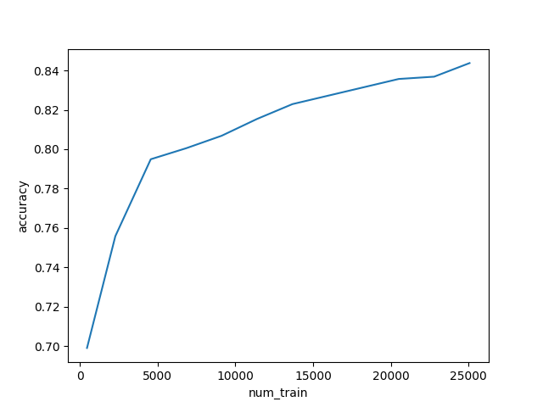
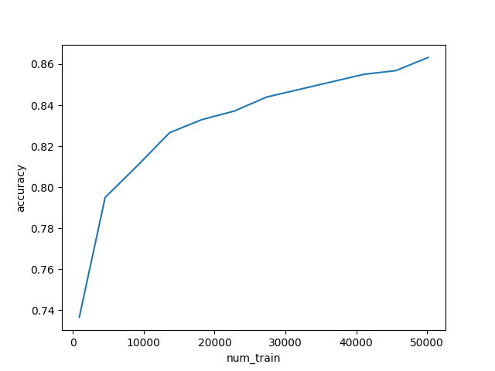
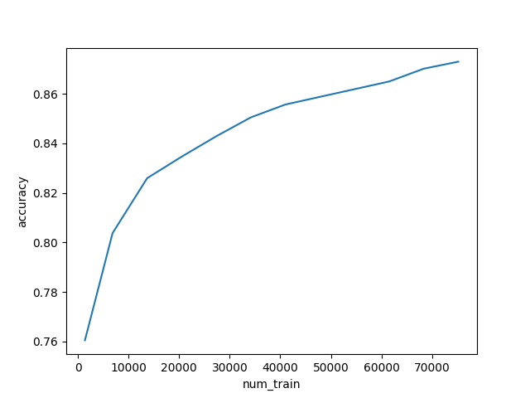
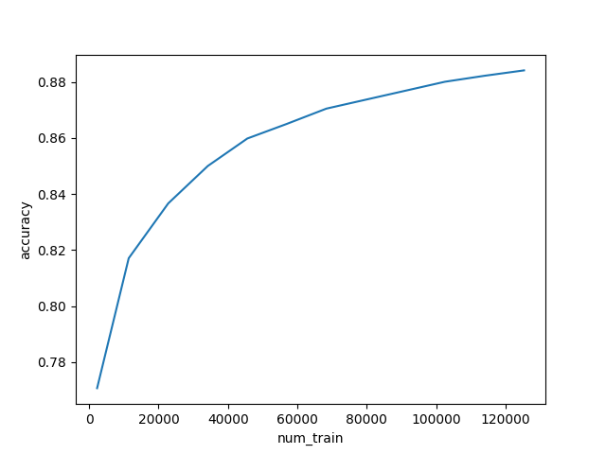
Accuracy by ISCXURL2016 & by Kaggle Dataset
accuracy0.1.png
accuracy0.2.png
accuracy0.3.png
accuracy0.5.png

Slide 29
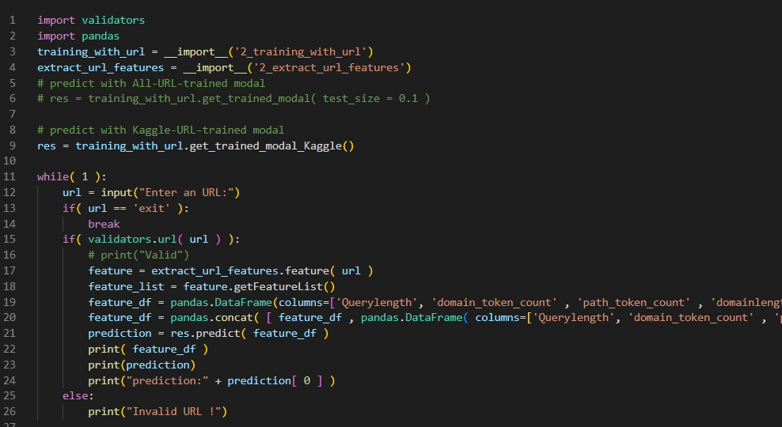
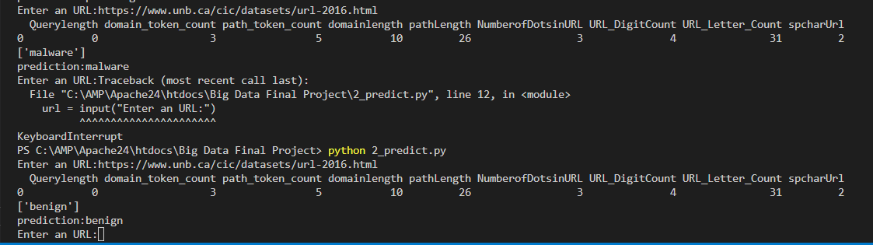
I. application
04
Prediction by given URLs
C:\AMP\Apache24\htdocs\Big Data Final Project\2_predict.py
Accuracy by ISCXURL2016 & by Kaggle Dataset
(Less than 10 seconds)
The prediction varies and it’s ridiculous!

Slide 30
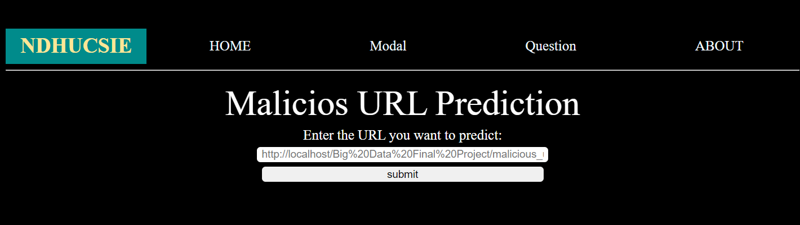
II. Website
It’s just a start!!!
FUTURE
LET USES ENTER AN URL
THE SYSTEM EXTRACTS THE FEATURES AND GIVES THE PREDICTION RESULT

Slide 31
Part 3
Issue
Conclusion

Slide 32
I. issue
01
SHORTCOMING
MISPREDICTION
OVERFITTING
LIMITATION OF THE DATASET VS. OVERWHELMING NUMBER OF URLS IN THE REAL WORLD

Slide 33
I. issue
02
FUTURE EVOLUTION
POSSIBLE SOLUTION?
TAKE THE AVERAGE OF THE PREDICTION
E.G., 6 TIMES OF BENIGN OUT OF 10
CONSIDER MORE COMPLICATED FEATURES

Slide 34
CONCLUSION
01
RELATION BETWEEN LEXICAL FEATURES AND TYPE
02
HIGH ACCURACY BUT APPLIED IN REALITY?

Slide 35
THANKS
☺

Slide 36
REFERENCES
Doyen Sahoo, Chenghao Liu, and Steven C.H. Hoi. 2019. Malicious URL Detection using Machine Learning: A
Survey. 1, 1 (August 2019), 37 pages. https://doi.org/10.1145/nnnnnnn.nnnnnnn
Mohammad Saiful Islam Mamun, Mohammad Ahmad Rathore, Arash Habibi Lashkari, Natalia Stakhanova and Ali A. Ghorbani, "Detecting Malicious URLs Using Lexical Analysis", Network and System Security, Springer International Publishing, pp. 467-482, 2016.
https://www.kaggle.com/datasets/sid321axn/malicious-urls-dataset
https://towardsdatascience.com/predicting-the-maliciousness-of-urls-24e12067be5

Slide 37
END

Slide 38
…

